Slide 1
System for AI based SIP Planning & Fund Recommendations
Intelligent AI-based financial advisory system designed to achieve investment goals by:
Leveraging Smart SIP Goal Planning which incorporates inflation-adjusted calculations for estimating monthly SIPs
Risk-matched Portfolio Optimization and tailored Asset Allocation strategies
Dynamic live data retrieval and powerful screening from AMFI, Value Research, and Yahoo Finance with comprehensive Fund Screening Engines
Enhanced AI-based profile scoring, comprehensive mutual fund and ETF profile analysis, and personalized recommendation for investment strategies
User-customized interactive visualization for investment illustration and fund comparison
Reasoning with LLM, rules-based deductive frameworks, and on-demand data fetching powered systems

Slide 2
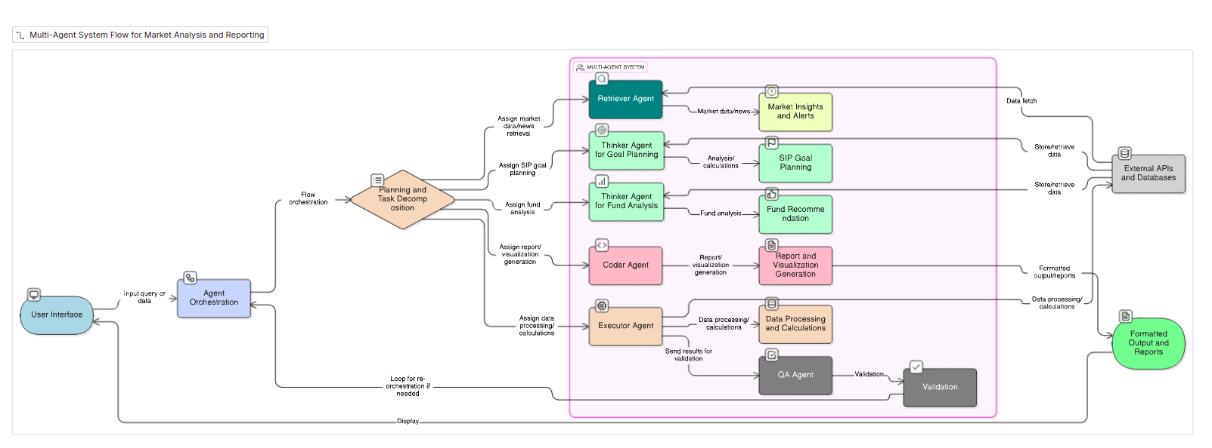
Architecture
UI : SIP Recommendation: Report based on User Inputs
Fund Recommendation: Report based on SIP Recommendation and Chat
Others: RAG for news feeds in form of PDF
MCP Server for API based data

Slide 3
